Slide 1
Programming Fundamentals
Lecture 28

Slide 2
Objectives
Exception Handling
  try, catch and throw blocks
  Multiple catch Blocks
  Generalized catch Block
  Re-throwing Exceptions
  Restricting Exceptions
  Exception Handling and Object Destruction
  Advantages of Exception Handling
C++ Templates
  The Need of Templates
  Function Templates
  Function Templates with Multiple Parameters
  Class Templates

Slide 3
Exception Handling

Slide 4
Types of Errors in Programming
The following are mainly errors or bugs that may occurred in any program
Logical Error
  In this error the logic implemented is incorrect. This error occurs due to less concentration of programmer or poor knowledge of programmer regarding program
Compilation Error (Syntax Error)
  This error is occurred due to use of wrong keywords, function or structure. This error is shown at compilation time of program
Run Time Error
  This error occurred at the run time. This error occurs when program crashes during run time, these are also called exceptions
Time Limit Error
  This error states that program takes more time than required time. This error occurs due to use of wrong logic or lengthy method in program

Slide 5
Exception Handling
Exception handling is the process of handling errors and exceptions in such a way that they do not hinder the normal execution of the program
Exceptions are of two types
  Synchronous Exceptions
    The exceptions which occur during the program execution due to some fault in the input data
    For example, error such as out-of-range, overflow, underflow etc
  Asynchronous Exceptions
    The exceptions caused by events of faults unrelated to the program and beyond the control of the program
    For example keyboard interrupts, hardware malfunction, disk failure etc
  In C++ on synchronous exceptions can be handled

Slide 6
Ways to Handle Exceptions
We can remove logical, compile time and time limit errors
But Exceptions are different. We can't eliminate exceptional circumstances; we can only prepare for them
The users will run out of memory from time to time, and the only question is what we shall do?
Our choices are limited to the followings
  Crash the program
  Inform the user and exit gracefully
  Inform the user and allow the user to try to recover and continue
  Take corrective action and continue without disturbing the user
It is not necessary that this method works for every program you write to automatically and silently recover from all exceptional circumstances, it is clear that you must do better than crashing

Slide 7
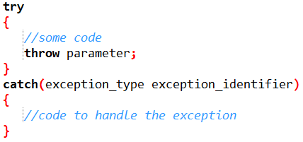
Exception Handling in C++
Exception handling provides a method to control the synchronous run time error
We can use following the keywords or functions to control synchronous runtime errors in C++
  try
  catch
  throw
These functions are used to control any synchronous exception
The general syntax of exception handling is given below

Slide 8
try, catch and throw Blocks
try Block
  The code which can throw any exception is kept inside (or enclosed in) a try block
catch Block
  catch block is intended to catch the error and handle the exception condition
  The code to handle the error is written inside the body of catch block
throw Statement
  It is used to throw exceptions to exception handler i.e. it is used to communicate information about error

Slide 9
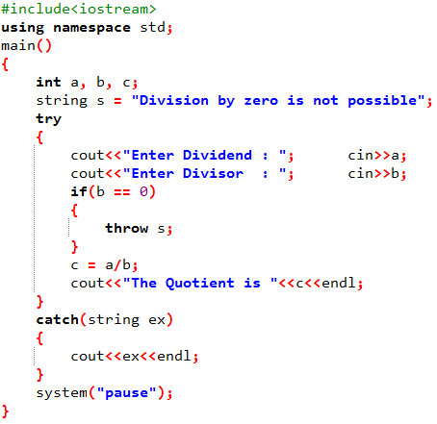
Exception Handling (Example 1)
When we divide two numbers and the divisor is 0, then a runtime error will appear and compiler will stop working
Here we will use exception handling
We will take the input inside the try block and check for 0 divisor, if divisor is zero then we will throw an exception
Inside the catch block we will display the error message

Slide 10
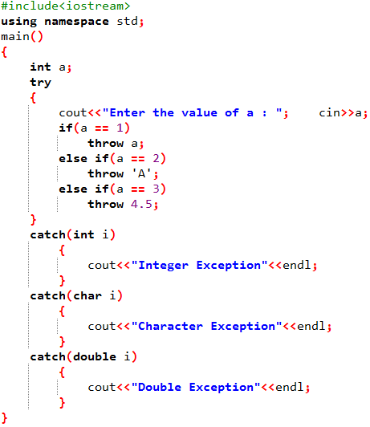
Using Multiple catch Blocks
We can use multiple catch blocks for a single try block
Multiple catch blocks are used when we have to catch a specific type of exception out of many possible type of exceptions i.e. an exception of type char or int or short or long etc
The catch block that matches with type of exception thrown is executed, while the rest of catch blocks are skipped

Slide 11
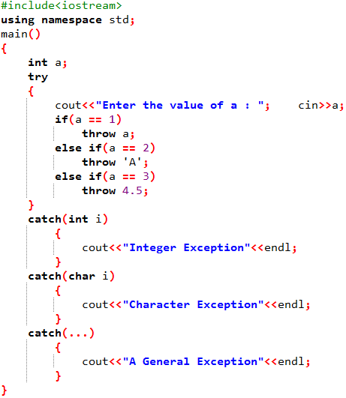
Generalized catch Block
The previous example will catch only three types of exceptions that are integer, character and double
If an exception occur of long type, no catch block will get execute and abnormal program termination will occur.
To avoid this, we can use the catch statement with three dots as parameter (...) so that it can handle all types of exceptions
It is sometimes called default catch block

Slide 12
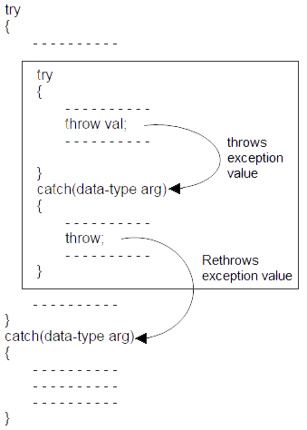
Re-throwing Exceptions
Rethrowing exception is possible, where we have an inner and outer try-catch statements (Nested try-catch)
An exception to be thrown from inner catch block to outer catch block is called rethrowing exception
Syntax of rethrowing exceptions is given below

Slide 13
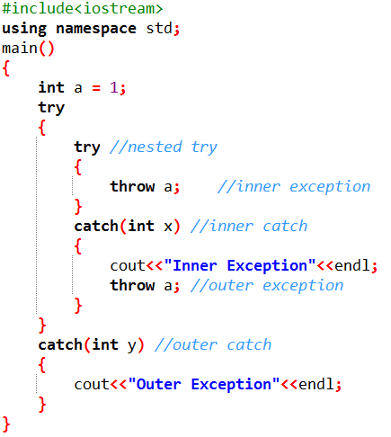
Re-throwing Exceptions (Example)

Slide 14
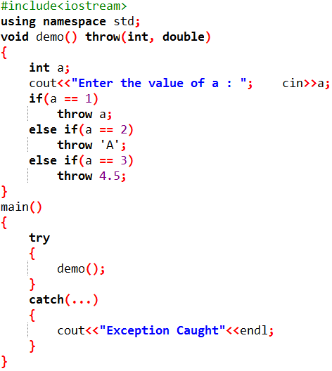
Restricting Exceptions
We can restrict the type of exception to be thrown, from a function to its calling statement, by adding throw keyword to a function definition
The above program will abort when we enter a = 2, because we have restricted the Demo() function to throw only integer and double type exceptions and Demo() is throwing character type exception

Slide 15
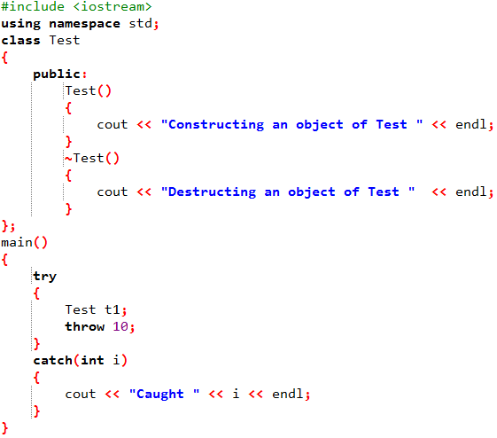
Exception Handling and Object Destruction
When an exception is thrown, destructors of the objects (whose scope ends with the try block) is automatically called before the catch block gets executed
That is why the above program prints “Destructing an object of Test” before “Caught 10”

Slide 16
Exceptions inside a Constructor
What happens when an exception is thrown from a constructor?
Have a look at the code “Exception_in_Constructor”
Destructors are only called for the completely constructed objects
When constructor of an object throws an exception, destructor for that object is not called as the object is not created fully

Slide 17
Advantages of Exceptions
Following are main advantages of exception handling over traditional error handling
Separation of Error Handling code from Normal Code
  In traditional error handling codes, there are always if else conditions to handle errors
  With try catch blocks, the code for error handling becomes separate from the normal flow
Functions/Methods can handle any exceptions they choose
  A function can throw many exceptions, but may choose to handle some of them
Grouping of Error Types
  In C++, both basic types and objects can be thrown as exception
  We can create a hierarchy of exception objects, group exceptions in namespaces or classes, categorize them according to types

Slide 18
C++ Templates

Slide 19
C++ Templates
Templates are used to prevent us from writing the same function or class separately for different data types
The simple idea is to pass data type as a parameter so that we don’t need to write the same code for different data types
Templates are the foundation of generic programming, which involves writing code in a way that is independent of any particular type
Generic programming is a technique where generic types are used as parameters in algorithms so that they can work for a variety of data types

Slide 20
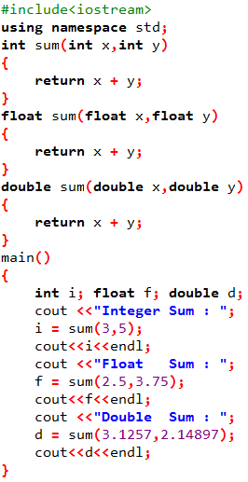
Need of Templates
To understand the need of templates let's first look at the following program
In this example, we defined a separate function to calculate the sum of three sets of numbers, each with a different data type
Isn't it hectic to define the same function again and again for different data types ?
This is where we need templates

Slide 21
Types of Templates
There are two types of templates in C++
Function Templates
  Function Templates prevent us from defining separate functions performing the same task for different data types
Class Templates
  Like function templates, class templates are useful when a class defines something that is independent of the data type

Slide 22

Function Templates
Function Templates prevent us from defining separate functions performing the same task for different data types
Let's look at the syntax of a function template for the sum function
Here we have declared the parameter of type T instead of int, float or double
We need to tell the compiler that this is a function template because it will not identify T ( since T is not a keyword )
For this, we need to include the following code before including T as shown below
This will tell the compiler that T is a type of template parameter

Slide 23
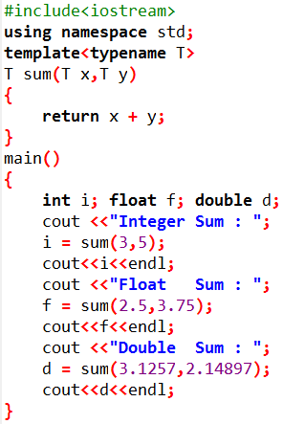
Function Templates (Example)
The following code will print the sum of different data types by using a function template
Here we declared a function template instead of writing three different functions for each data type
T sum( T x, T y) This is the definition of the function template which is the same as that of function
This tells us that both the parameters are of type T and the return value is also of type T
We can also write class keyword in place of typename keyword while declaring the template parameter

Slide 24

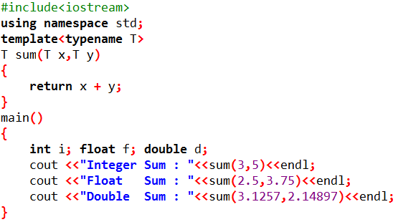


How Templates Work
Compiler Internally Generates
and Add Below Code
Compiler Internally Generates
and Add Below Code
Compiler Internally Generates
and Add Below Code

Slide 25
Different Parameters in Function Template
In the previous example, both the parameters of the function template were of the same type. Hence we declared T for both
But what if the first parameter is of a different type from the second?
Suppose that we are multiplying two numbers and data types of both the numbers are different
Now we will declare the function template with two types of template parameters T1 and T2
Where T1 is the datatype of its first parameter and T2 is of the second parameter
The return type will depend on the automatic type conversions
For example if the first parameter is int and second one is float then return type will be float

Slide 26
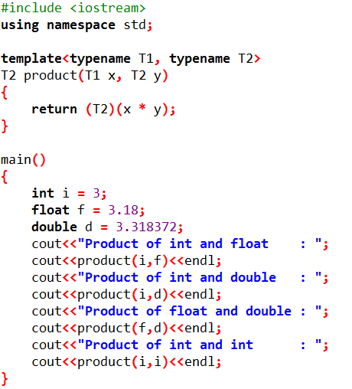
Different Parameters in Function Template (Example)

Slide 27
Class Templates
We can create class templates just like function templates
Class templates are used when the data type of attributes vary from object to object
Consider two students in a class and we want to calculate the total marks of each of them in two subjects
Suppose the marks of the first student in both the subjects are integer values and that of the second student floating values
Code is on next slide

Slide 28
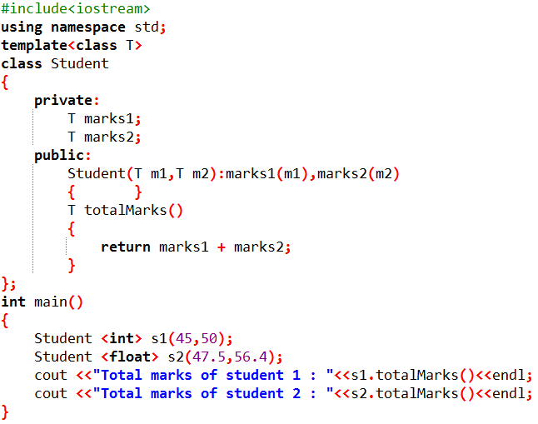
Class Template (Example)
While defining the object in main program we need to specify the data type of attribute used, the syntax is given below
Class_name <datatype> object_name(arguments)

Slide 29
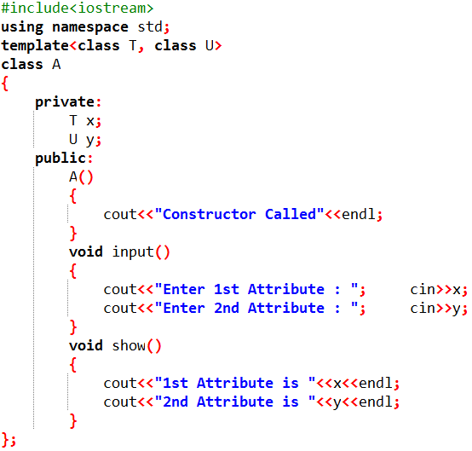
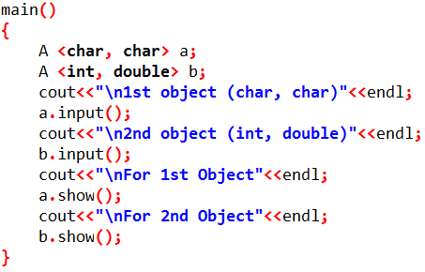
Multiple Arguments in Class Template
Like normal parameters, we can pass more than one data types as arguments to templates
Consider the following example

Slide 30
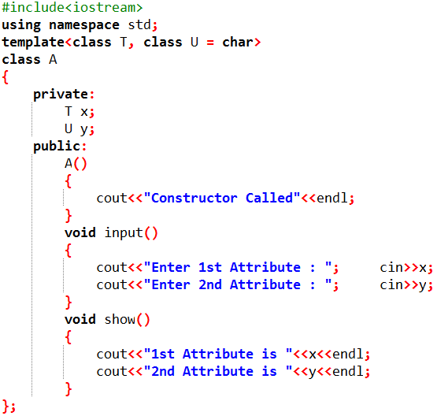
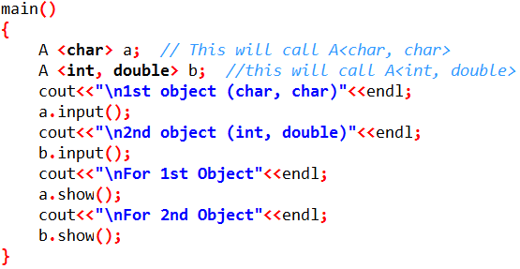
Default Data Type in Class Template
Default data type can be set while defining the template
When object is created, if the user passes the data type then passed data type is used, otherwise default data type is used

Slide 31
Do You Know About?
Decision Making in C++
Iterative Structures in C++
Functions and parameter passing
1D Arrays
2D Arrays
Pointers
Structures
Objects, Classes and Methods
Constructors and Destructors
Operator Overloading
Inheritance
Virtual Functions
Friend Functions
UML Class Diagrams
Polymorphism
Composition and Aggregation
File Handling
Templates
Exception Handling
If you know about majority of these topics, then you have surely learned something from this course ☺

Slide 32
I hope you enjoyed this course and
Learned some new things
Good Luck for your exams

